Slide 1


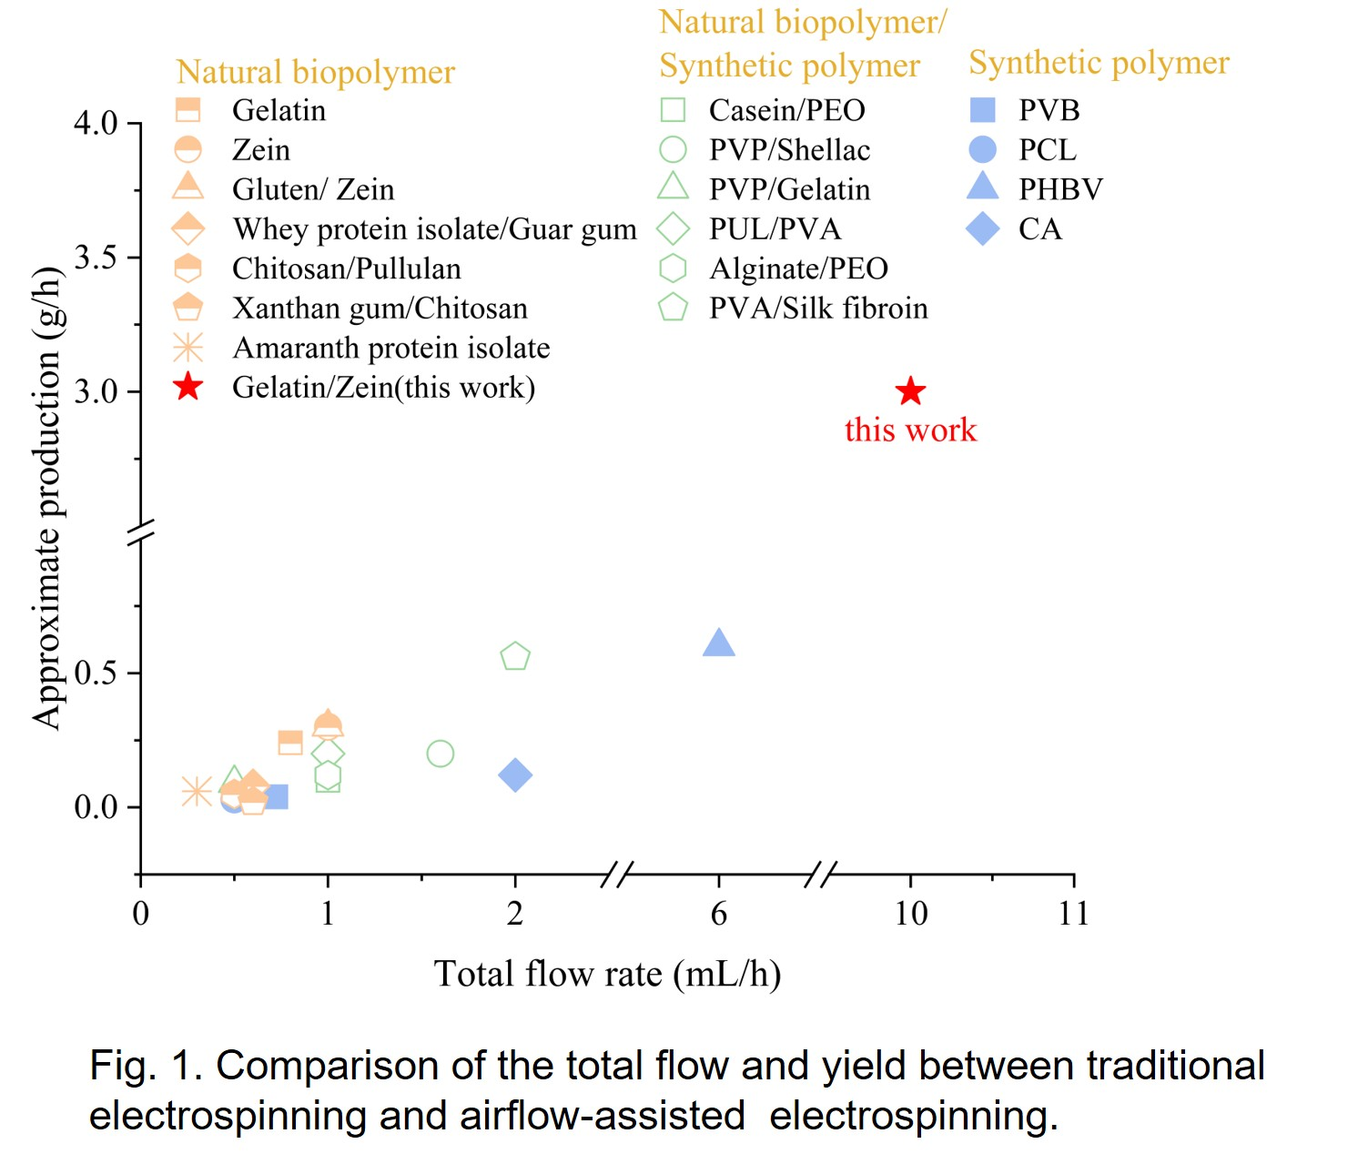
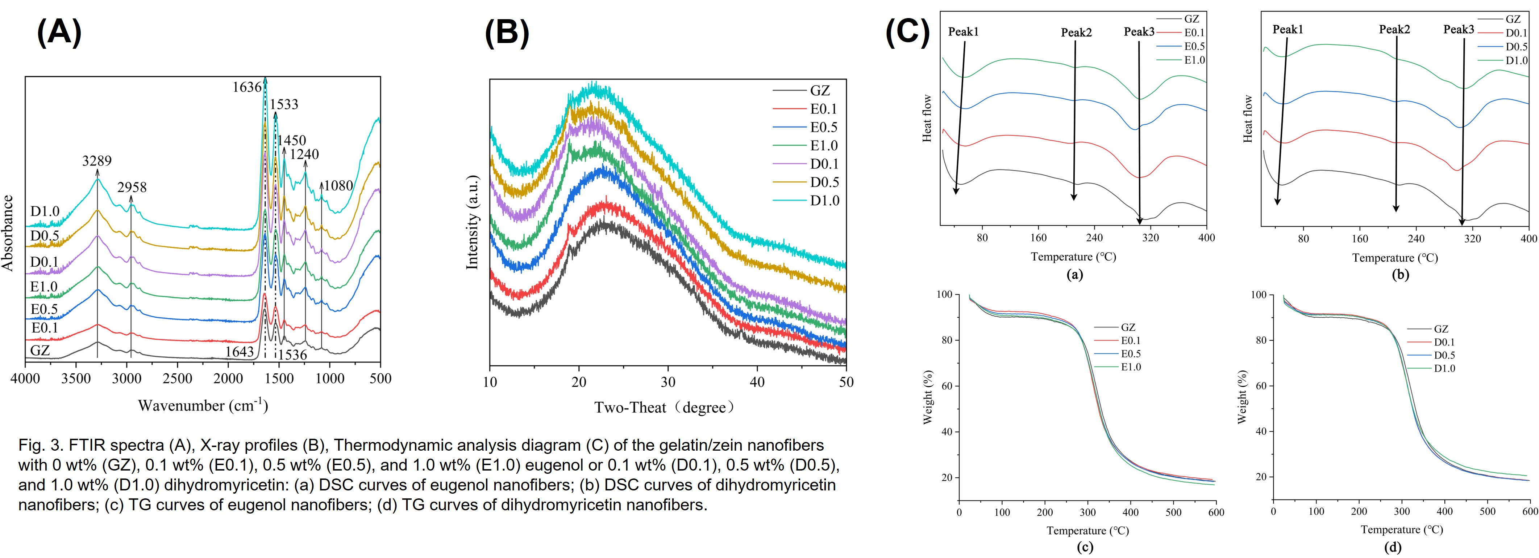
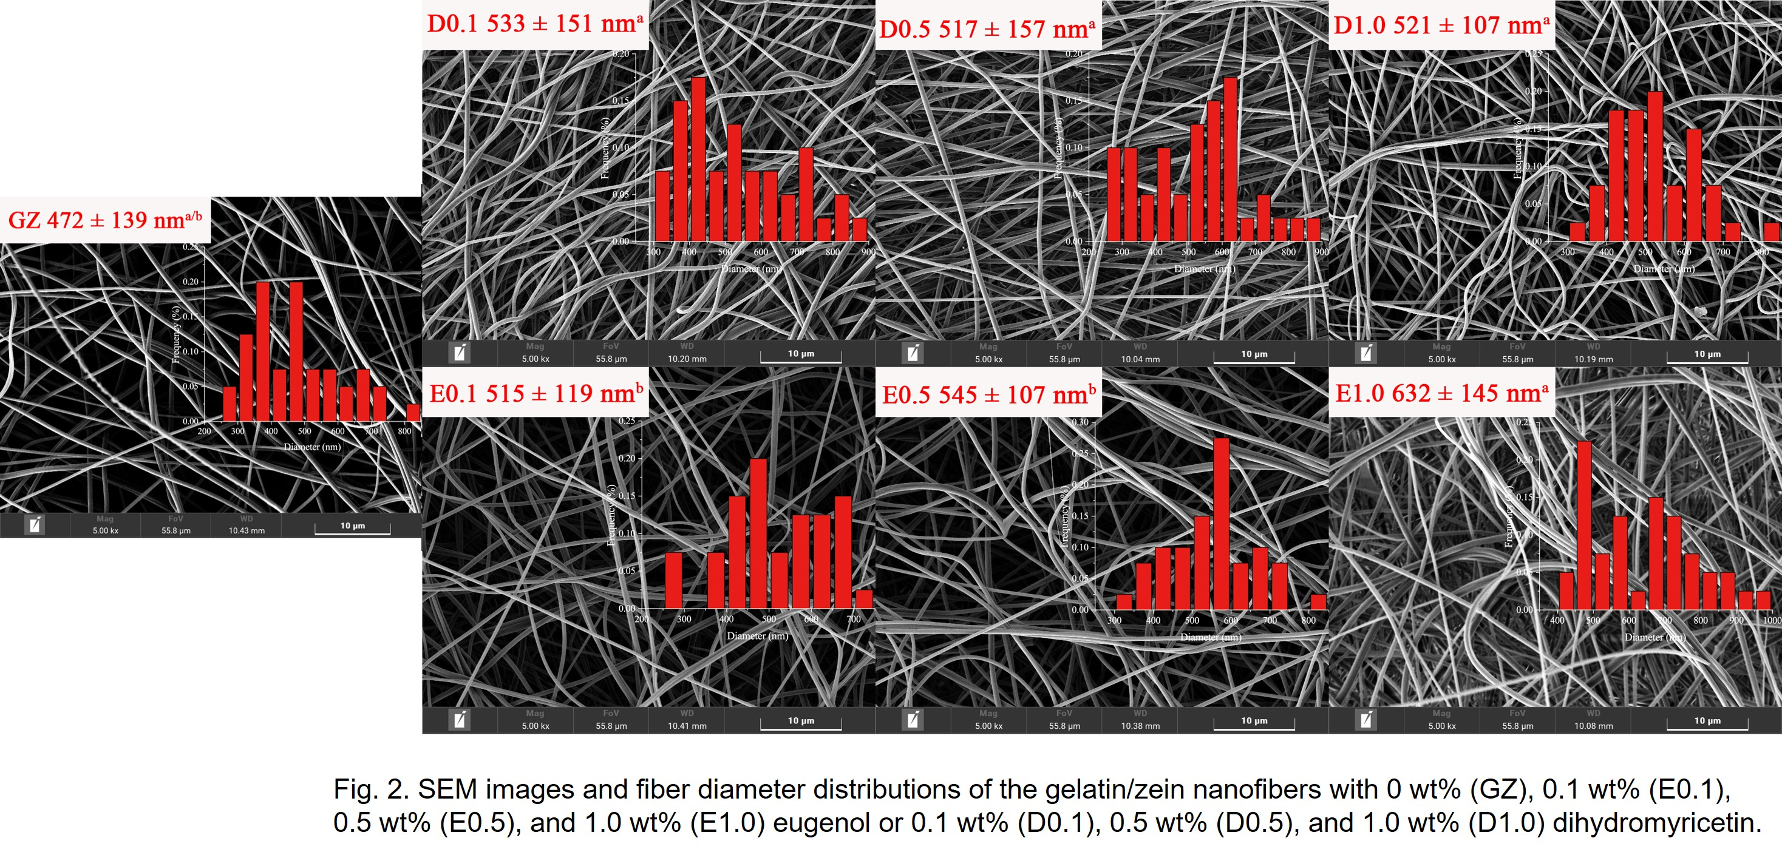
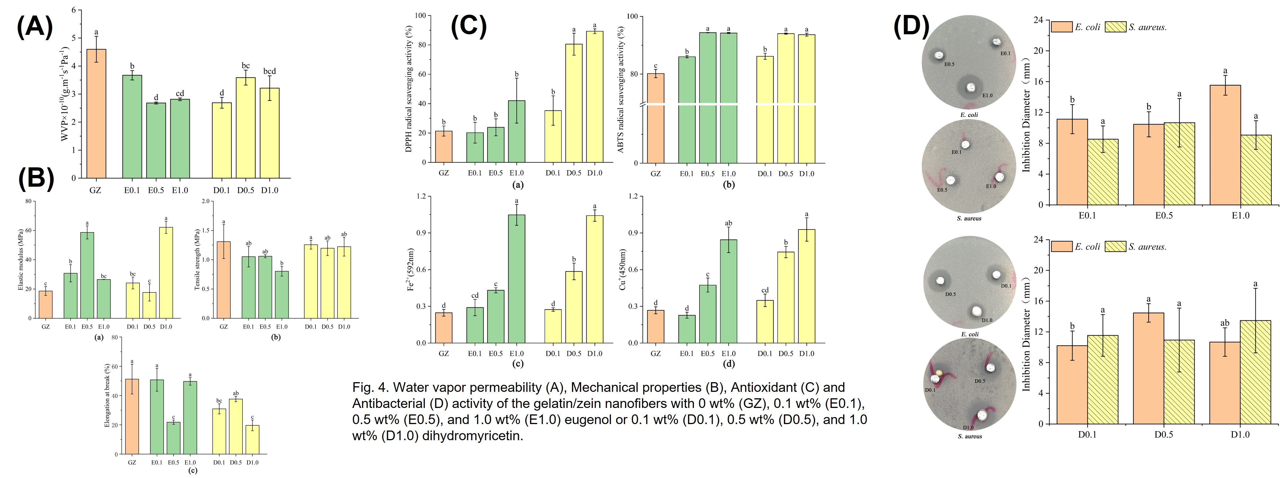
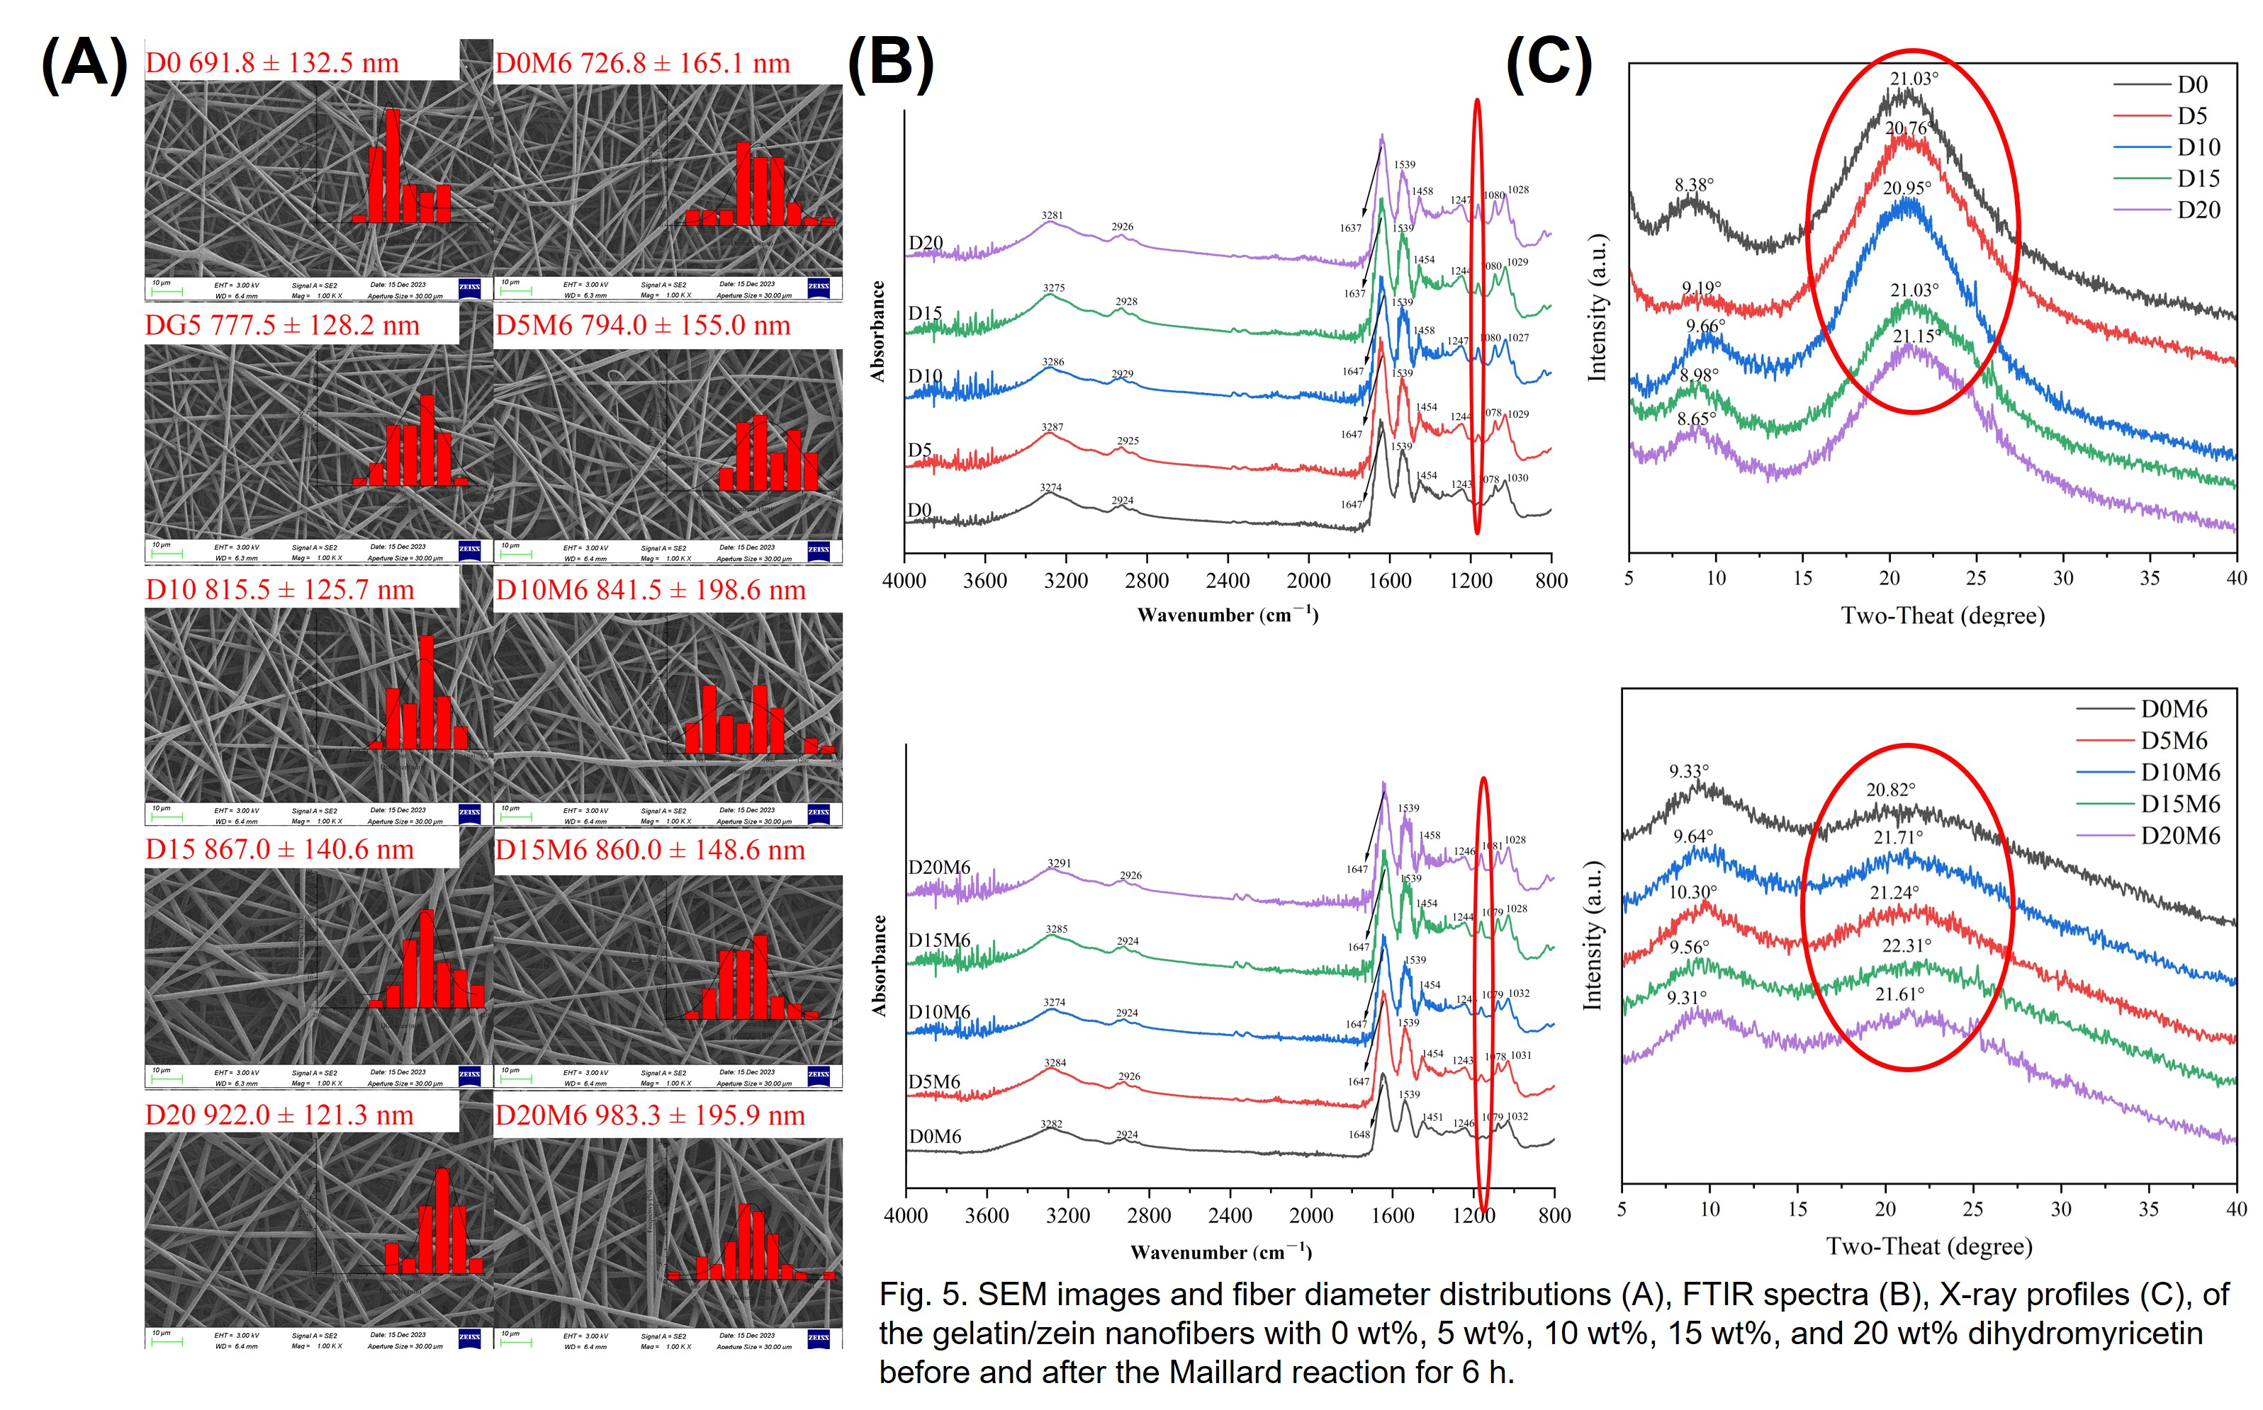
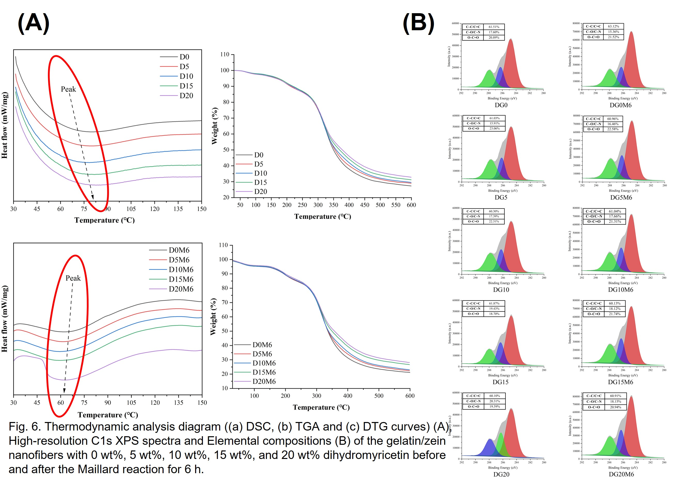
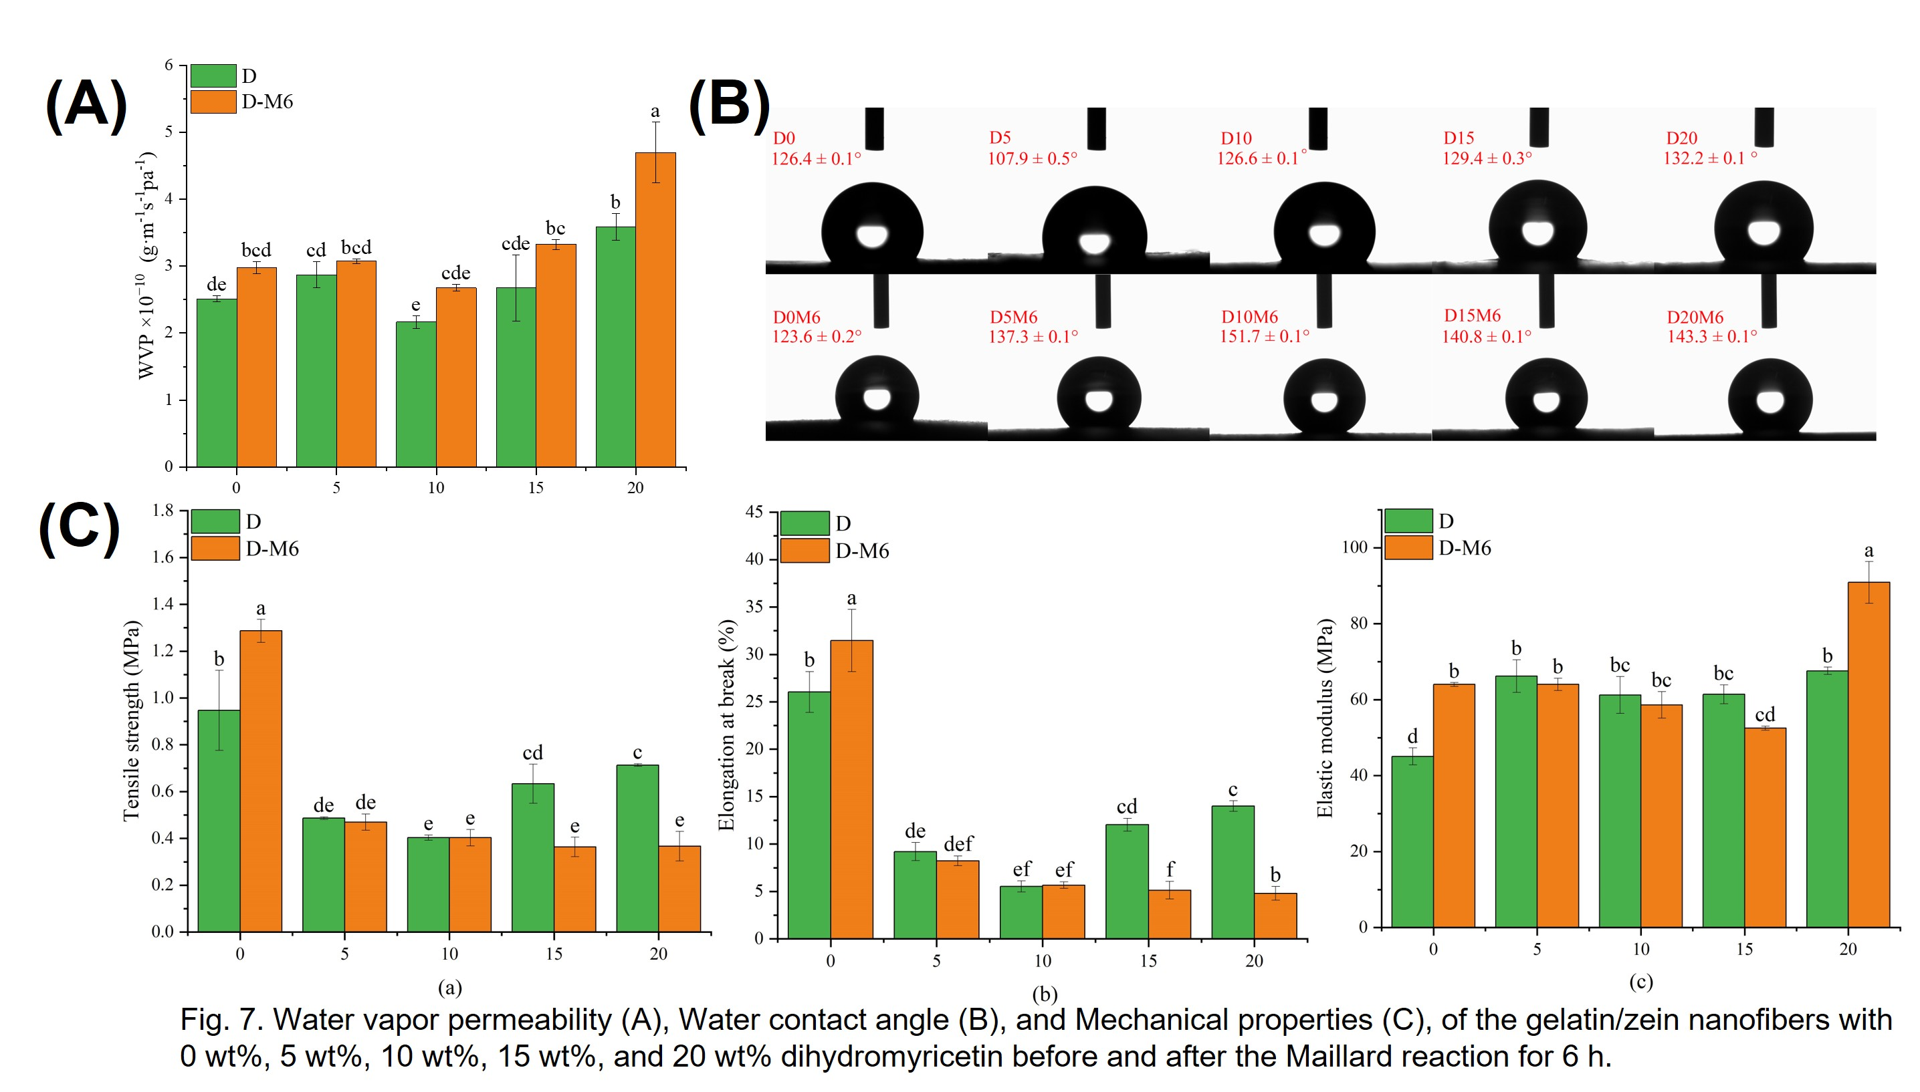
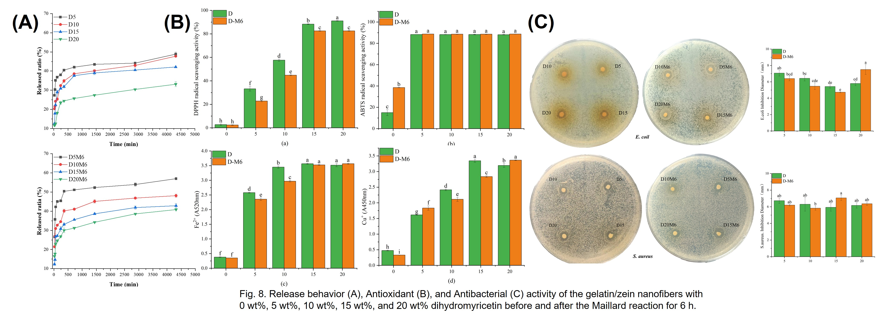
FSMILE 2025
Comparison of Eugenol and Dihydromyricetin Nanofibers: Electrospinning and Maillard Reaction Effects
October 04-07, 2025
@Morioka & ZOOM Cloud
Songqi Liu ^{1, 2}, Yaqin Hu ^{1,*}
1 College of Food Science and Engnieering, Hainan Tropical Ocean University, 572022, Sanya, Hainan, China
2 Sanya Oceanographic Institution, Ocean University of China, 572024, Sanya, Hainan, China
International Symposium on Food Communications and Sustainable Agri-Aqua Food Systems
Connecting Primary Industries, Academia, and Society through the SDGs
Contact Information:
lsqsongqi@gmail.com
Introduction
Phenolic compounds such as eugenol and dihydromyricetin (DHM) exhibit great potential in food packaging due to their excellent antioxidant and antibacterial properties. However, their application is limited by poor water solubility and short half-biological -life.
Results
Conclusions
The study has demonstrated five key points: First, air-assisted electrospinning is a highly effective method for boosting the production rate of nanofibers. Second, this technique can successfully load high concentrations of DHM. Third, the Maillard reaction can effectively crosslink the fibers. Fourth, this reaction alters the nanofibers' properties, by disrupting the protein's crystalline structure. And finally, this structural change promotes a faster initial release of DHM.
• The air-assisted setup increased natural polymer nanofiber yield tenfold over traditional methods.
• Dihydromyricetin was successfully loaded into the nanofibers, which exhibited effective functional properties.
AIM
The purpose of this study was to develop and characterize gelatin/zein nanofibers loaded with dihydromyricetin as a promising alternative to eugenol-loaded nanofibers for active food packaging, aiming to overcome the limitations of poor water solubility and short half-life of these phenolic compounds while evaluating their physical and functional properties.
Acknowledgements
This work was financially supported by Scientific Research Foun dation of Hainan Tropical Ocean University (RHDRC202117 and RHDRC202307) .
Method
Gelatin/zein nanofibers loaded with eugenol or dihydromyricetin were fabricated using electro-blowing spinning.
The use of the Maillard reaction (60°C, 50% relative humidity) as a mild crosslinking method for high-concentration dihydromyricetin nanofibers was investigated.
The physical (morphology, water vapor barrier, mechanical strength) and functional (antioxidant, antimicrobial) properties of the developed nanofibers were characterized and compared.
References [1] Wen P, Zong M-H, Linhardt R J, et al. Electrospinning: A novel nano-encapsulation approach for bioactive compounds [J]. Trends in Food Science & Technology, 2017, 70: 56-68.
[2] Mendes A C, Stephansen K, Chronakis I S. Electrospinning of food proteins and polysaccharides [J]. Food Hydrocolloids, 2017, 68: 53-68.
[3] Li L, Kang W, Zhuang X, et al. A comparative study of alumina fibers prepared by electro-blown spinning (EBS) and solution blowing spinning (SBS) [J]. Materials Letters, 2015, 160: 533-536.
[4] Zhang Y, Deng L, Zhong H, et al. Impact of glycation on physical properties of composite gluten/zein nanofibrous films fabricated by blending electrospinning [J]. Food Chemistry, 2022, 366: 130586.
[5] Li M, Yu H, Xie Y, et al. Fabrication of eugenol loaded gelatin nanofibers by electrospinning technique as active packaging material [J]. LWT - Food Science and Technology, 2021, 139: 110800.
[6] Liu D, Mao Y, Ding L, et al. Dihydromyricetin: A review on identification and quantification methods, biological activities, chemical stability, metabolism and approaches to enhance its bioavailability [J]. Trends in Food Science & Technology, 2019, 91: 586-597.
• Successful High Loading: FTIR confirmed increased DHM incorporation without major morphological impact.
• Structural Disruption: XRD revealed Maillard-induced steric hindrance disrupted protein crystal packing.
•Thermal stability decreased due to a Maillard reaction-induced looser network from crystalline disruption, a conclusion supported by elemental analysis.
• The Maillard reaction enhances the initial burst release within the first 500 minutes, followed by a sustained release up to 72 hours

